Slide 1

Capstone Project Phase 2
Blockchain Private Key Security
Supervisor: Mr. Alex Keselman
Karin Shpigelman
Nitzan Shani
Notes:
Hello everyone my name is karin and this is my partner nitzan, and we are going to talk about blockchain private key security. Our supervisor is mr. alex keselman.

Slide 2
Overview
Problem Overview
Algorithm & Development
Evaluation
1
2
3
4
5
Introduction
Challenges

Slide 3
1.
Problem Overview

Slide 4

The problem
Unauthorized access to a private key can result in significant financial loss.
Notes:
The main problem is the risk of unauthorized access to the private key used in cryptocurrency exchanges and large-scale projects based on blockchain technology. Private keys are essential for accessing and managing assets associated with a cryptocurrency wallet, and unauthorized access to these keys can result in the loss of assets.
Currently, many methods for securing private keys rely on the use of a single key, which is stored in one place, making it a prime target for hackers. Additionally, many existing methods require human intervention to access the private key, which can lead to delays and errors.

Slide 5
2.
Introduction

Slide 6
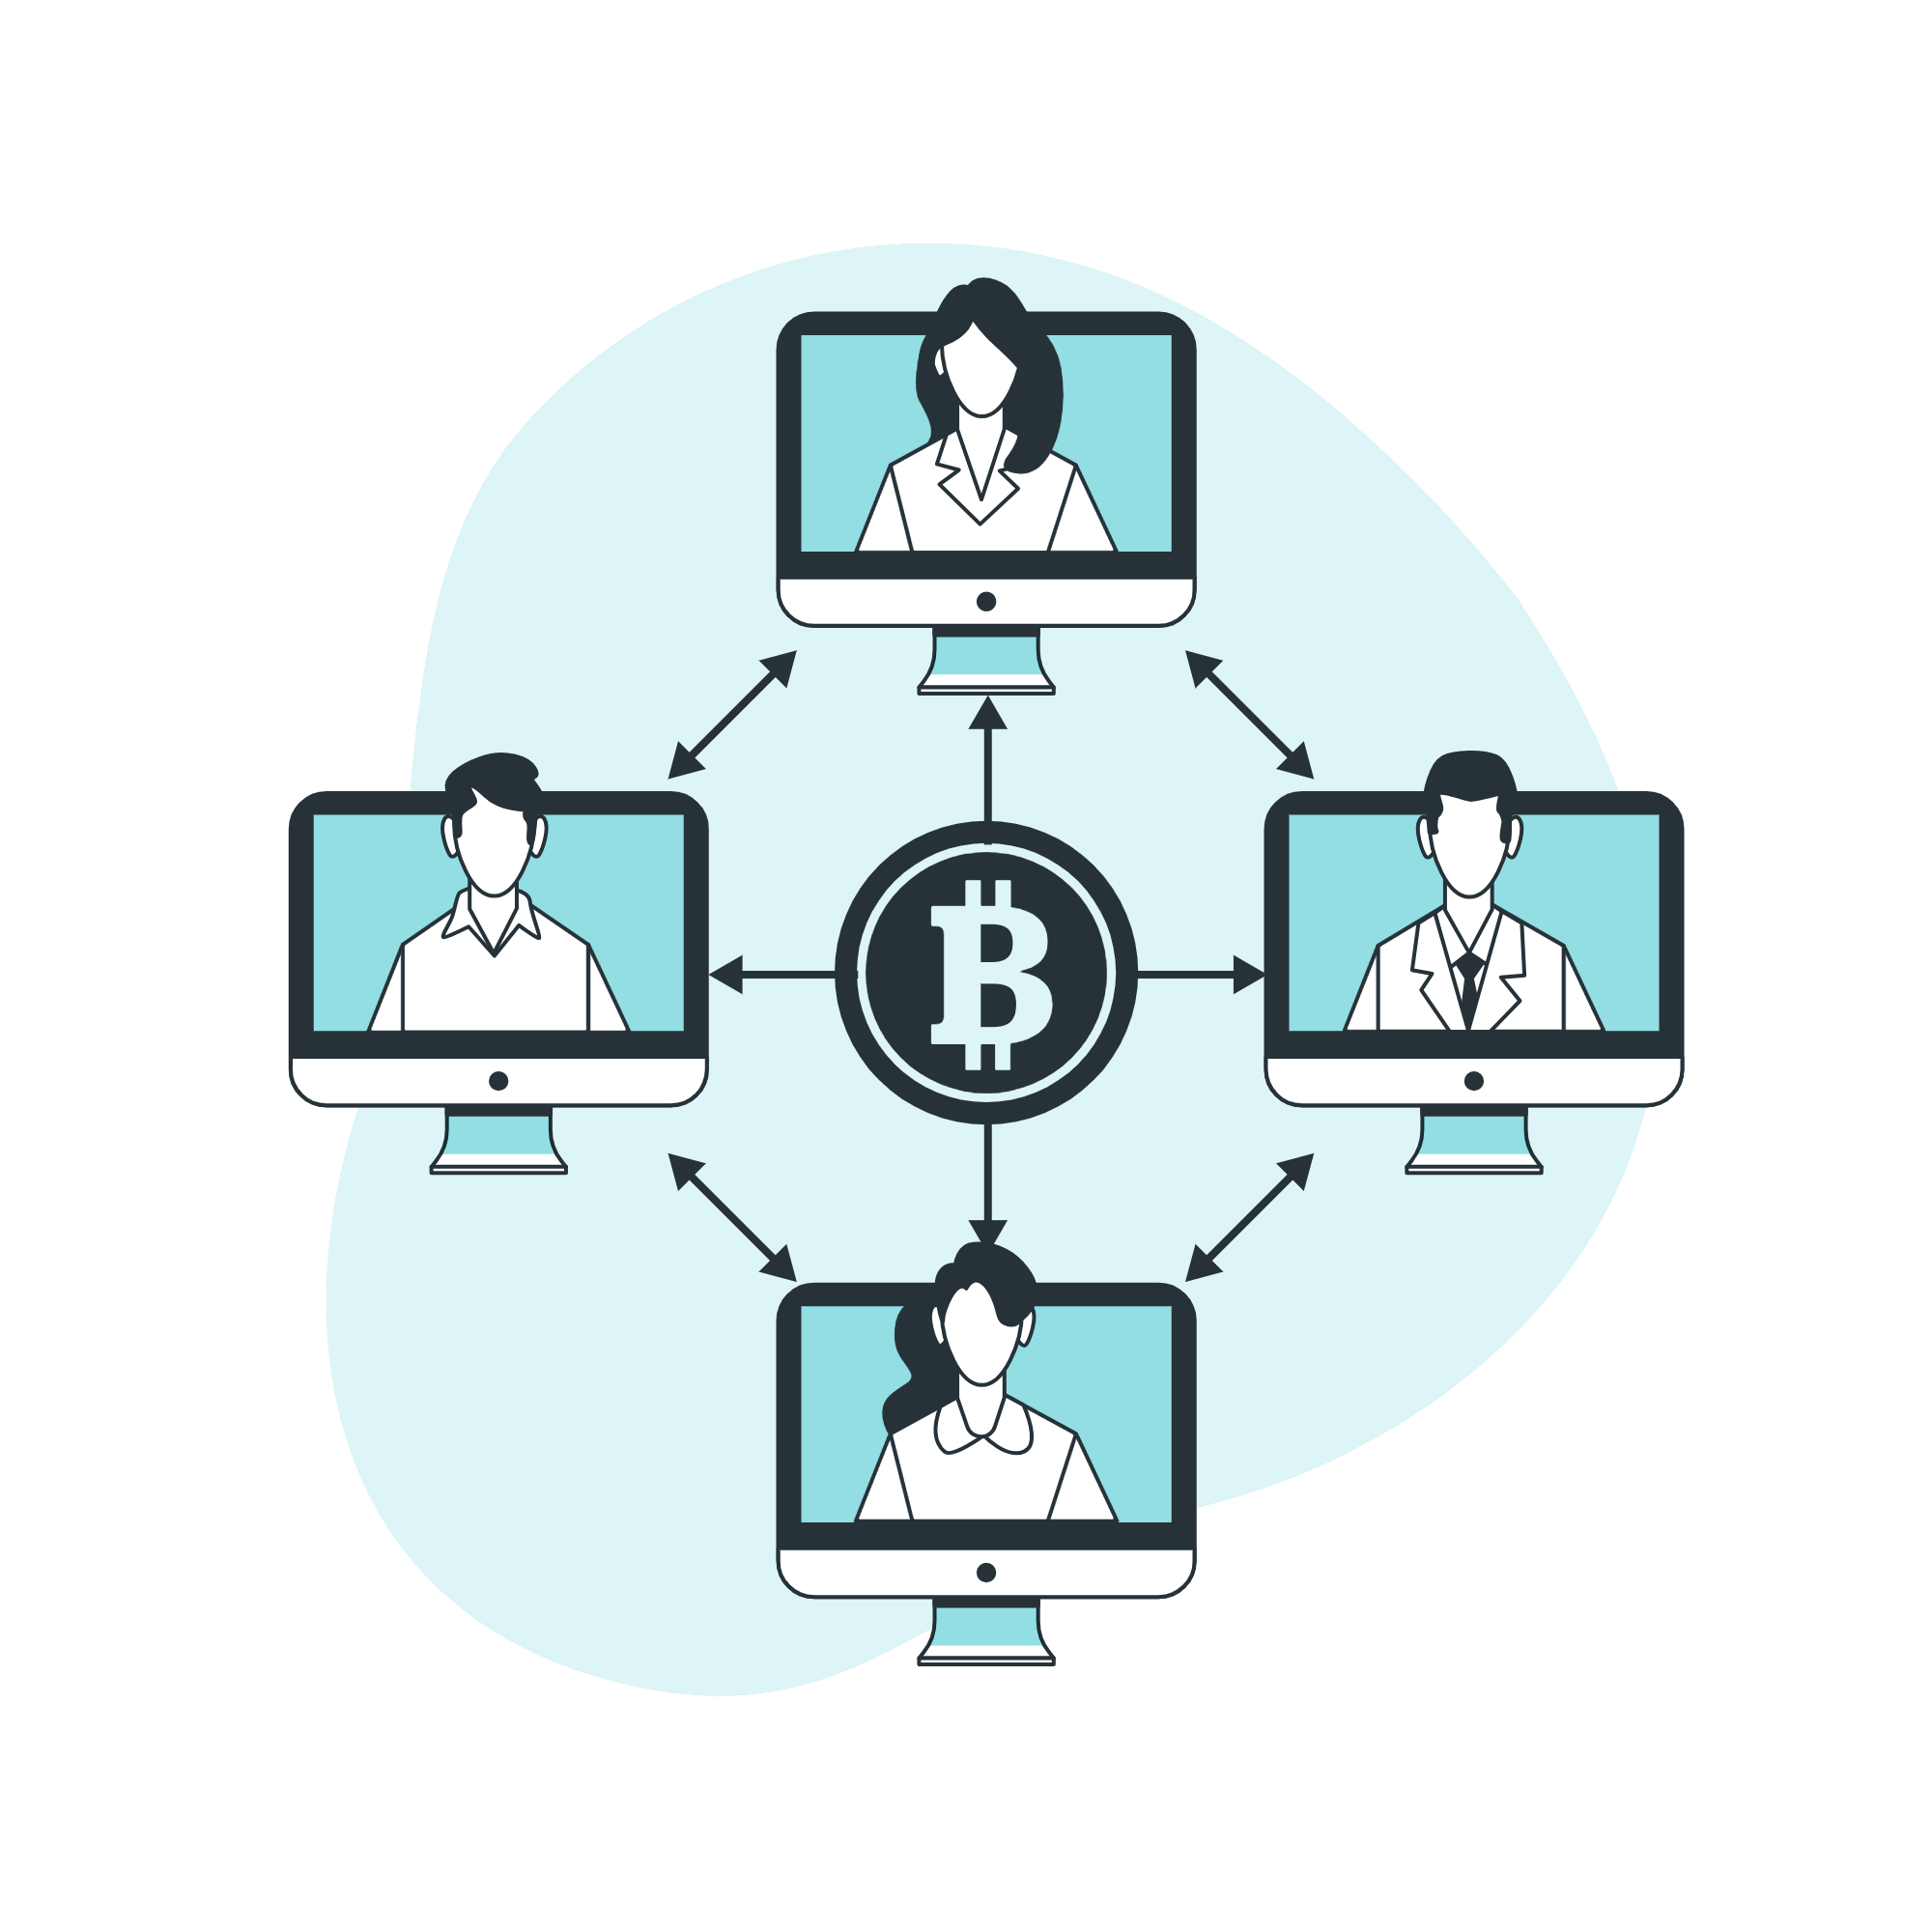
Introduction
Cryptocurrency
virtual currency that uses cryptography for security.
Blockchain
digital ledger of transactions
Notes:
A cryptocurrency is a virtual currency that uses cryptography for security. It Bitcoin, the first and most widely used cryptocurrency, was created in 2009. Transactions with cryptocurrencies are recorded on a public digital ledger called a blockchain.
A blockchain is a digital ledger of transactions that is decentralized and distributed across a network of computers. Each block in the chain contains a number of transactions, and every block is linked to the one before it, forming a chain of blocks. This structure creates a permanent, unchangeable record of all transactions on the network.

Slide 7
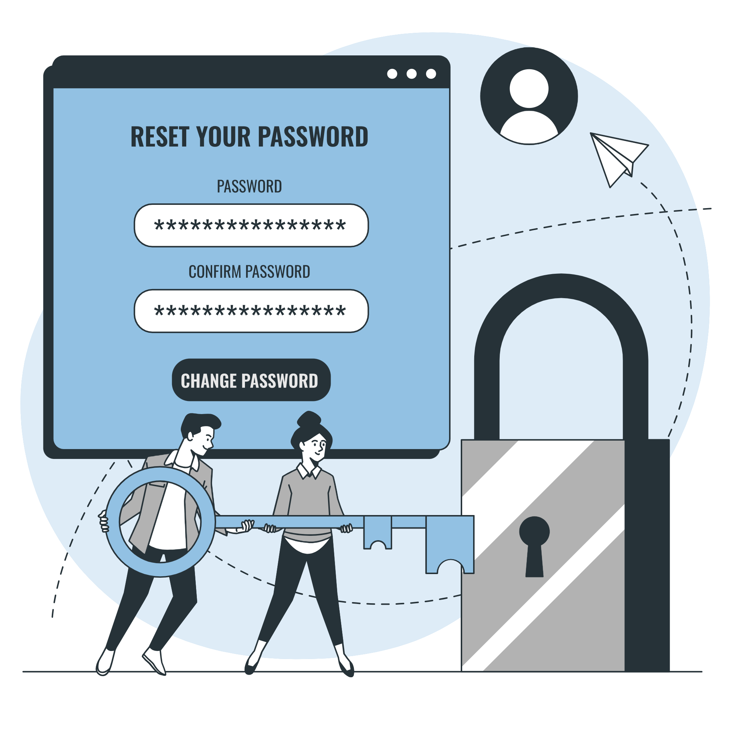
Introduction
Transaction
digital record of an action that is recorded on the blockchain network.
Private and Public Key
pair of keys that are used to encrypt and decrypt data.
Notes:
transaction is the transfer of digital assets or information between participants. It involves a sender creating a digital signature using their private key, specifying transaction details like recipient address and amount, and broadcasting it to the network. Network participants verify the transaction's authenticity, integrity, and sufficient funds
In cryptography, a public key and a private key are a pair of keys that are used to encrypt and decrypt messages. In blockchain, these keys are used to secure transactions and manage ownership of digital assets.
public key is a string of characters that represents a digital address on the blockchain network, similar to a bank account number. It is used to receive digital assets and view the transaction history of a particular address. Public keys can be shared publicly, and anyone can send digital assets to a public key.
A private key, on the other hand, is a secret key that is used to access and manage the digital assets associated with a particular public key. It is used to sign digital transactions and transfer ownership of digital assets. The private key should be kept secret and protected, as anyone with access to it can sign transactions and move digital assets without the owner's permission.
digital signature is a way to prove the authenticity of a digital document or message, and that it was created by the rightful sender and it has not been tampered with.In blockchain technology, a digital signature is used to authenticate and authorize transactions. It is a mathematical algorithm that is applied to the content of a transaction, creating a unique "fingerprint" that can be used to verify the authenticity of the transaction.
The Bitcoin blockchain uses the Elliptic Curve Digital Signature Algorithm (ECDSA) for digital signatures. ECDSA is a widely-used digital signature scheme that is based on the mathematics of the elliptic curve cryptography (ECC). ECC is a form of public-key cryptography that is considered to be more secure than traditional RSA (Rivest–Shamir–Adleman) encryption for a given key size.

Slide 8
Biggest Crypto Exchanges Hack
 | Then | Now
Bitfinex 2016 | $72,200,000 | $2,545,533,536
CoinCheck 2018 | $487,387,361 | $926,988,827
Binance 2019 | $41,167,638 | $149,990,022
* In the last decade
Notes:
Coincheck A Japanese cryptocurrency exchange.The target of the hack, as in most cases, was the hot wallet of the exchange, from which 523 million NEM tokens were stolen
Hong Kong-based Bitfinex, one of the largest cryptocurrency exchanges in the world, lost about $72 million worth of bitcoin in a hack.
hackers were somehow able to trick the BitGo algorithms, forcing them to approve transactions, and withdrew about 120,000 BTC from the exchange’s hot wallet. The immediate effect on the price of Bitcoin was a sharp drop of about 20% following the news of the hack. H
Binance, one of the largest cryptocurrency exchanges
Hackers used a variety of tactics — including phishing and viruses — to obtain a large number of two-factor authentication codes and API keys. The hackers made off with 7,074 BTC
It's worth noting that these are just a few examples of many exchange hacks that have occurred in the past decade. The crypto space is constantly evolving and exchanges have to adapt and improve their security measures to prevent such events, as the value of cryptocurrencies has increased and so has the interest of hackers.

Slide 9

3.
The Algorithm & Development

Slide 10
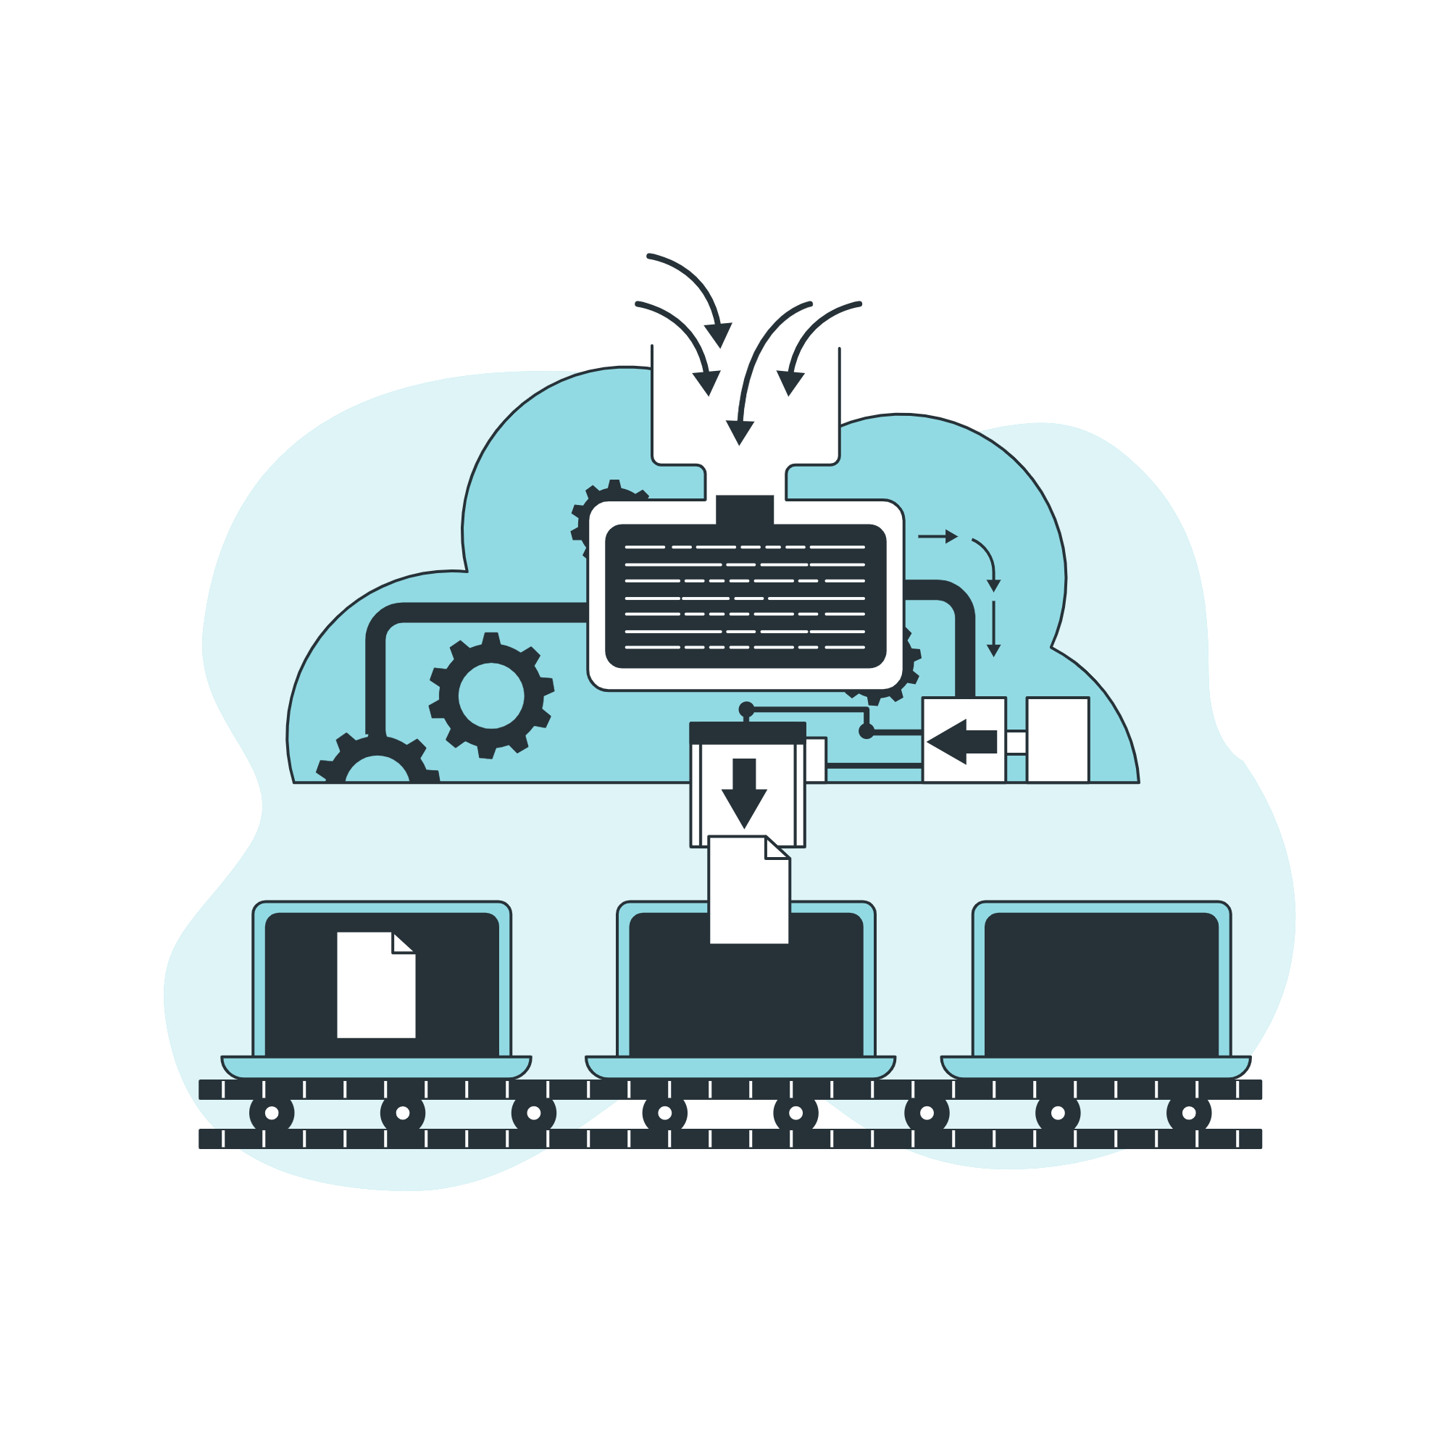
Algorithm
The private key is a string of 64 characters length, 256 bits.
Splitting the private key into smaller parts and storing them in blocks.
Distributed across multiple servers.
Notes:
The proposed algorithm addresses these issues by splitting the private key into smaller parts and storing them in blocks, which are then distributed across multiple servers. This approach makes it more difficult for hackers to access and compromise the assets associated with the private key, as they would need to gain access to multiple servers and reassemble the key. Additionally, the algorithm does not require human intervention to access the private key, which eliminates the possibility of delays and errors caused by human intervention.
The private key is a string of 64 characters length, 256 bits.
The private key is divided into 16 smaller parts of 4-character, which are stored in 8-character blocks and distributed across 16 servers.ensuring that each char of the private key is stored twice in two different servers.
adding an extra layer of security. This process ensures that in case of a server failure, the private key can still be accessed and providing an added layer of security against hacking.
In the event of server malfunction, the system has been engineered to maintain functionality through the implementation of redundancy, wherein each character is replicated and stored on two separate servers.

Slide 11
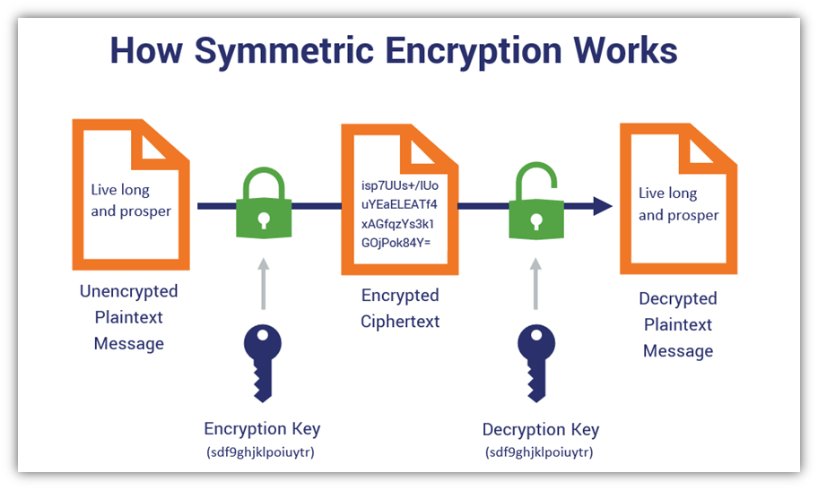
Algorithm
Before transmission, the partitions will undergo encryption.
symmetric algorithm - AES - 256 - CBC
Notes:
We encrypt each block before we sent it to a server.
The AES-256-CBC algorithm is selected for encryption in order to provide robust security measures. it is widely regarded as a highly secure symmetric encryption algorithm, utilizing a large 256-bit key that renders brute-force attacks computationally infeasible. Its compatibility with various cryptographic libraries and frameworks ensures widespread applicability across different systems and platforms. The adoption of CBC mode enhances security by incorporating a chaining mechanism that prevents patterns in the plaintext from being revealed in the ciphertext, thereby safeguarding against specific types of attacks. Moreover, AES-256 is recommended by industry standards organizations like NIST, reinforcing its credibility and ensuring adherence to established security practices. By employing AES-256-CBC encryption, the system guarantees the confidentiality and integrity of the transmitted partitions, bolstering overall security measures.

Slide 12
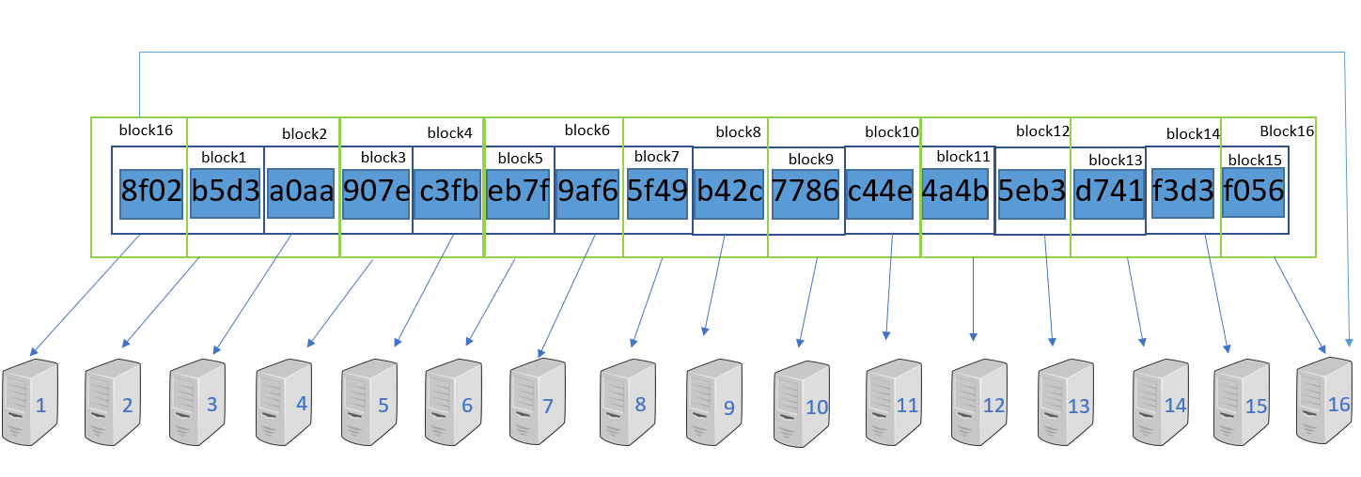
Algorithm
Notes:
This is an example of how our algorithm works.
We can see that the private key that is a 64 characters string, is divided to small parts that contains 4 characters, each.
Each part is saved in 2 different blocks, and each block is saved in a different server.
In total each character is saved in 2 different servers, so our algorithm can handle if there is a problem in one of the servers.
We can see that each part is saved in 2 following blocks, while last block contains the first part and the last part of the private key.

Slide 13

3.1
Diagrams

Slide 14
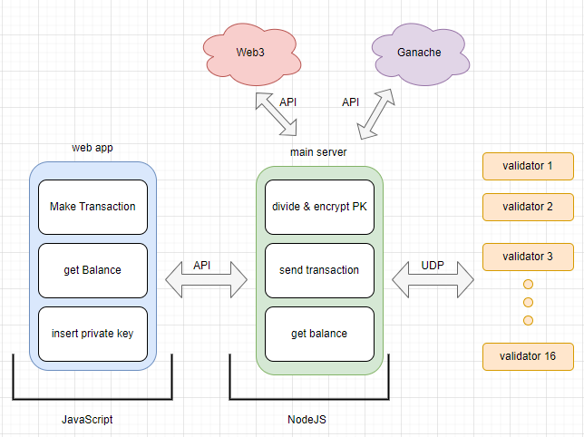
Architecture
Notes:
This is an architecture diagram of our system. The client size is implemented with js and contains 3 main operations. The first one is insert pk. The user insert his own pk of account and the system stores it according to the algorithm that explained. The second operation in get balance, the user can checkout his balance anytime by only insert his public key.
And the third operation is make a transaction,the user can perform transactions to any other account by insert his public key, while he has enough in his account.
The system contains the main server, which implemented with js and nodeJS. The server get the pk of the user, divide it encrypt each part and stores it in the validators through udp.
He also provide the current balance of the user and make transactions, by using WEB3 - Infura and ethers API in order to communicate with remote ethereum blockchain.
We also use Ganache, which is also a free service that helps us test our system, by providing private and public keys.
To facilitate communication with the storage servers, the primary server will maintain a mapping of the IP addresses of all storage servers using a data structure such as a map.

Slide 15
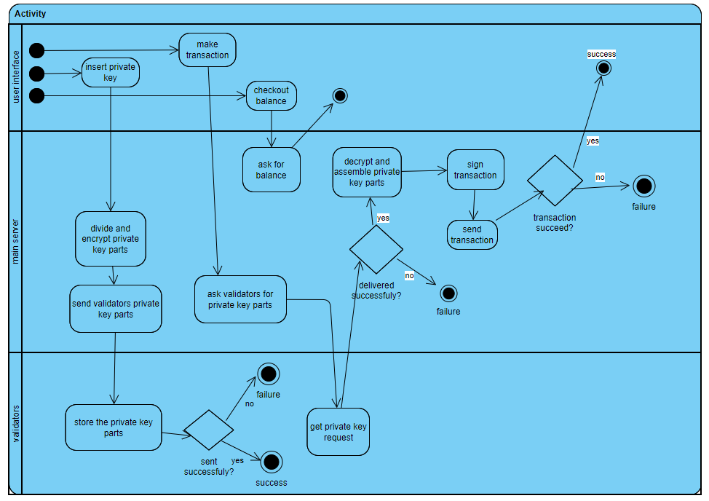
Activity
Notes:
This is an activity diagram of our system. We can see that we have 3 different component in the system.
In the user interface,

Slide 16
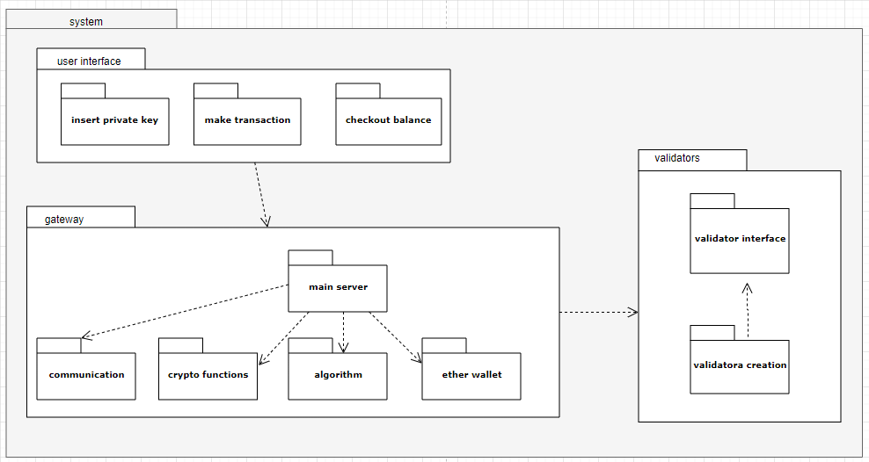
Package
Notes:
This is a package diagram, we can see that we have the three operations that the user can perform, that we discussed earlier.
We have the main server that, in charge of the communication with the different validators. We have crypto functions that include the encryption and decryption of the key parts. The algorithm that include the division and assemble of the pk parts. And the ehthers wallet that include communication with web3.
the validators component contains

Slide 17

3.2
Used Technology

Slide 18

Used Technology
Web3
aims to create a decentralized and peer-to-peer internet infrastructure.
Ganache
provides a local development environment with a personal blockchain.
Notes:
web 3:
Web3 refers to the third version of the web, which aims to create a decentralized and peer-to-peer internet infrastructure. It incorporates blockchain technology and other decentralized technologies to enable the development of applications that are trustless, transparent, and resistant to censorship. Web3 encompasses various technologies such as blockchain, smart contracts, decentralized storage, decentralized identity, and more.
We use it in order to perform the get balance and make transaction operations.
This technology allows us to communicate with the blockchains node - read and update data threw the services infura and ethers api
Ganache: A service that provides a local development environment with a personal blockchain that developers can use for testing and debugging their smart contracts and decentralized applications (dApps) without the need to deploy them on a public network.
We use it in order to test and debug our system

Slide 19
3.3
Demonstration

Slide 20


Slide 21

4.
Challenges

Slide 22
Challenges
Synchronization
Component Failure
man-in-the-middle attack
Notes:
I will present few of the main challenges that we handle while creating the system.
First challenge is component failure. Our algorithm include many validators that stores parts of the pk, so we depend on an external company that gives us service. The pk is at risk of being lost by a fault in one of them.
Our algorithm can handle that case , so if case there is a problem of communicate one or two of the validators, we can still assemble the key.
The second challenge is man in the middle attack. Is an attack which the attacker can interfere the communication and steal the data.
Thats why we use symmetric encryption in order to communicate the validators.
The third challenge is synchronization. We need to synchronized the different validators so we assemble the key back in a correct way. Thats why we need extra component which is the main server that incharge of handle the private key when he send it to the validators and when he assemble it back.
If all the servers are stored in one location or same cloud provider and it is compromised, the private key is at risk of being stolen.
distribute the servers across multiple locations and cloud providers.
The servers need to be kept in sync with each other in order to ensure that the private key can be reconstructed when needed.
Master-slave replication- the master server is responsible for managing and distributing the private key, and the slave servers are responsible for storing the key.
Master-slave replication: One way to synchronize servers is to use master-slave replication, where one server acts as the master and the other servers act as slaves. The master server is responsible for managing and distributing the private key, and the slave servers are responsible for receiving and storing the key.
Man in the middle attack is an attack That attacker could intercept the communication between the servers and modify the private key or the way it is divided and distributed. This would allow the attacker to gain access to the private key and compromise the assets associated with it, despite the algorithm's security measures.
To mitigate the risk of these attacks, we implement additional security measures - symmetric encryption. To ensure the integrity and confidentiality of the communication channel between the servers.

Slide 23
5.
Evaluation Plan

Slide 24
Evaluation Plan
Test number | Test case | Expected result
1 | Dividing the private key | division should be according to the algorithm
2 | Encrypting and decrypting the private key parties | each part should be encrypted
3 | Sending the private key parties to the correct servers | each server should have its part
4 | making a new transaction | the transaction is accepted in blockchain
5 | making a new transaction in case one of the servers is down | the transaction is accepted in blockchain
6 | making sure the transaction is recorded in blockchain | we will see the current balance
Notes:
These few of the main test cases that we test our system.

Slide 25

Thanks!
Any questions?

